Slide 1
High Performance Surgery Network
OCTOBER 9, 2015

Slide 2

We solve healthcare problems for self funded employer’s
The continued rise in healthcare costs is one of self funded employer’s biggest business challenges
The BridgeHealth High Performance Surgery Network provides a solution that improves healthcare quality and outcomes while significantly lowering the cost of healthcare.

Slide 3
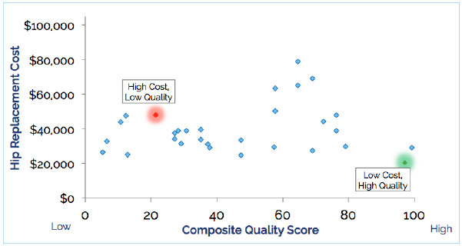
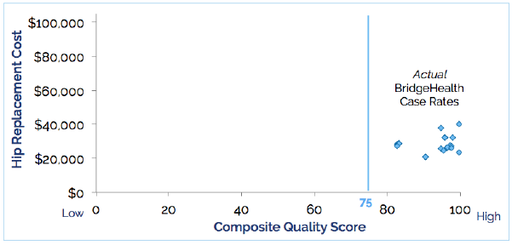

Predictable Cost and Quality
Members directed to top facilities for the appropriate procedure
Using a predictable, pre-negotiated case rate for planned surgeries
Before:
After:

Slide 4
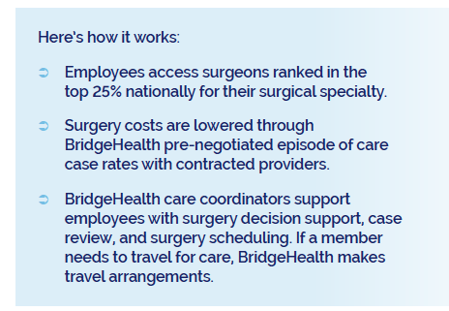
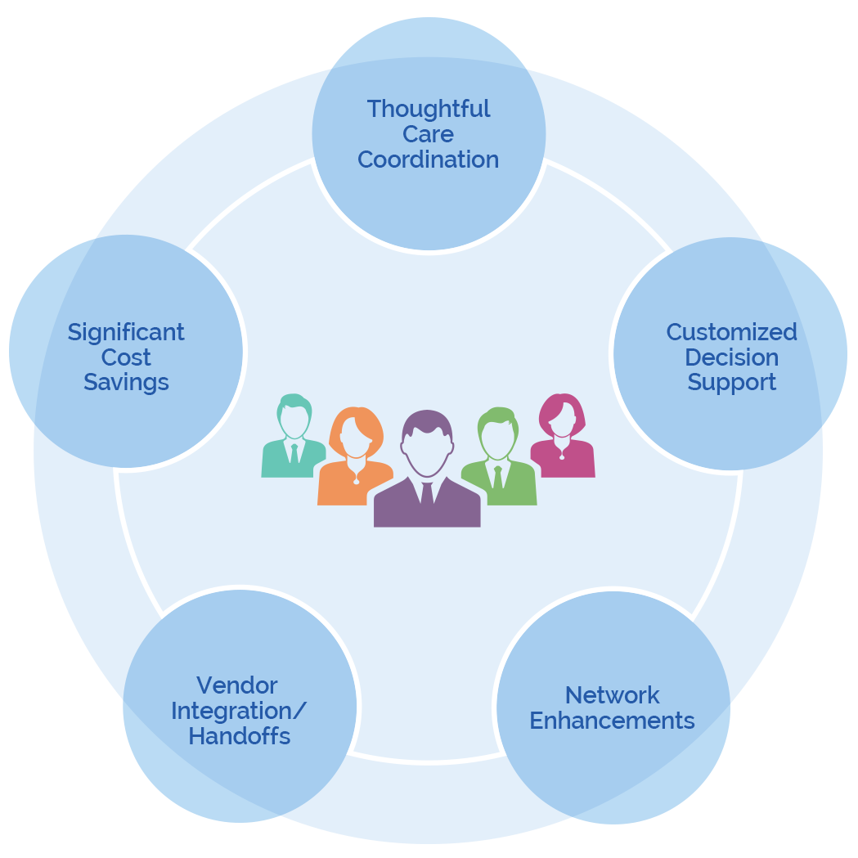
Value Proposition for Self Funded Employers

Slide 5
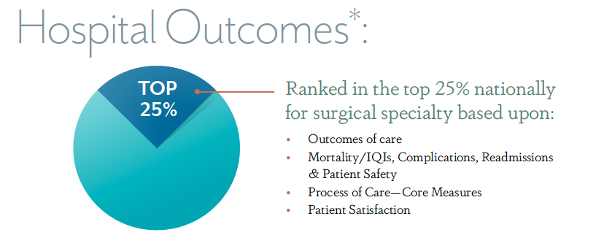

Provider Quality Credentialing

Slide 6
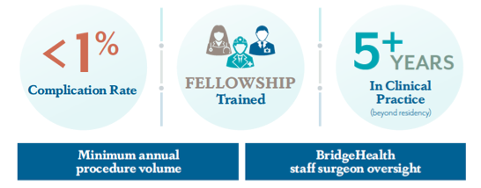
Surgeon Qualifications

Slide 7

Standard Episode of Care
Bundles include:
Surgery
(including anesthesia, facility charges, surgeon/assistant surgeon fees, etc.)
*Physician Post-Op Services
(up to 90 days)
*specific to traveling patients who are unable to see their surgeon for post-op care
Physical Therapy – inpatient or occurring prior to first post-op
Consultation
Pre-Admission Testing
Pre-Operative Appointment
Surgeon Post-Op Services (up to 90 days)
Continuing Physical Therapy

Slide 8
All-in-One Pricing & Advance Payment
Bundles include:
PRE-OP
Pre-admission testing and pre-op consultation
Hospital admission Surgery Anesthesia Doctors’ fees Implant device Facility fees Hospital stay Lab test Care coordination
SURGERY
All professional services, facility charges and related expenses between pre-op and post-op
FOLLOW-UP
Any post-surgery care through first post-operative follow up visit
Physical therapy Home healthcare Skilled nursing care DME used prior to first post operative follow up
BridgeHealth is payer for the case rate

Slide 9
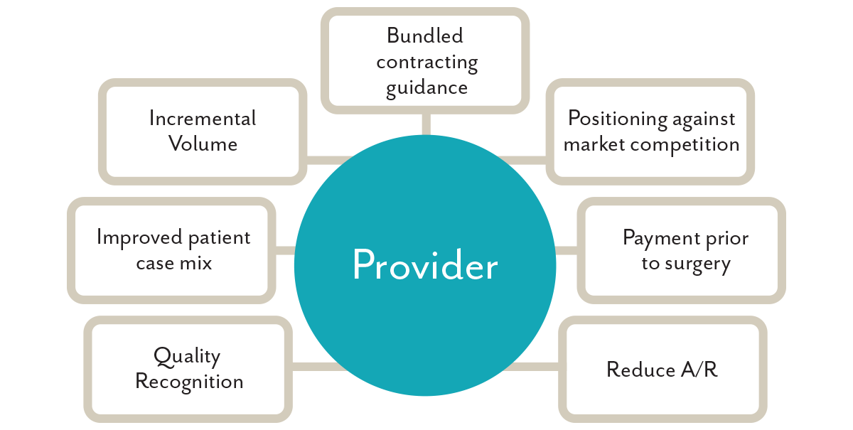
Network Value Proposition

Slide 10
Care Coordination Process
1
2
3
4
Program Explanation
Decision Support Coaching
Consent & Records Collection
Review of Provider Options & Provider Selection
5
6
7
8
Case Review & Acceptance (Surgery scheduled or avoided)
Coordination of logistics around surgery (travel in some cases)
Surgery
Post-surgery instructions and follow-up

